Slide 1
Shyam Lokhande
Abhishek Dhamdhere
Vaishnav Bhujbal
Neha Bhosale
Forensic Data Recovery SQL Server Database

Slide 2
DATA RECOVERY USING MSSQL
Student: Shyam Nagnath Lokhande
Professor: B.C. Julme

Slide 3
TABLE OF CONTENTS
1
2
INTRODUCTION
RELATED WORKS
3
4
INTERNAL STRUCTURE
SYSTEM TABLES
5
6
DATA RECOVERY
CONCLUSION

Slide 4

1
Introduction
Importance Of Data Recovery.
Data Recovery can be done using :
Log Based Data Recovery
Engine Based Data Recovery

Slide 5
2
Related Work
DBMS Dependent Forensic Model
Database Forensic Model
Previous works on the Data Recovery
AL-Dhaqm et al , Flores and Jhumka
Fowler, Khanuja and Adane
Toombs

Slide 6
2.1 Database Forensic Model
Identification
Collection
Analysis
Validation
Interpretation
Report
Presentation

Slide 7
2.2 DBMS Dependent Forensic Model
Preparation
Incident Verification
Artifact Collection
Analysis

Slide 8
3
Internal Structure of the MSSQL Database
Internal Structure of the MSSQL database consists of four parts
Page
Record
Large Data
Tornbits

Slide 9
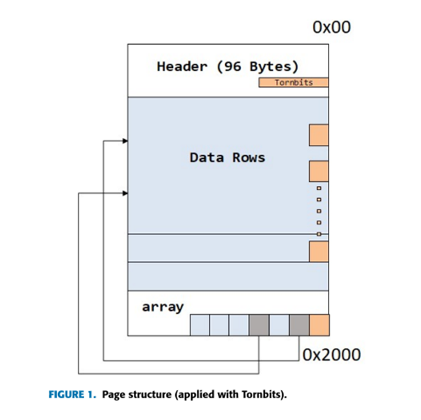
3.1 Page
Smallest unit of MSSQL data file
Default size is 8,192 bytes
Consists of :
page header
data row
row offset array

Slide 10
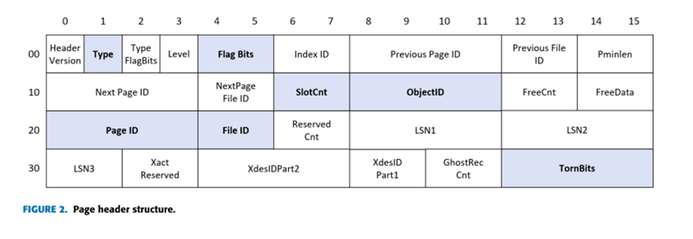
3.2 Header
96 bytes in size : 64 bytes is metadata and 32 bytes is data to be stored
7 fields in the header are used to recover data :
type , flag bits, slotcnt, pageID , fileID and checksum(tornbits).

Slide 11
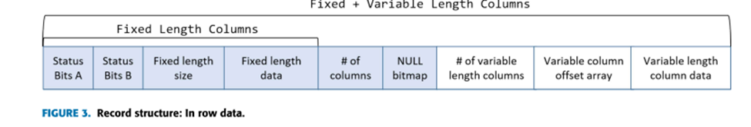
3.3 Record
A record is stored in a data row of Type 1 page.
If the size of the record is less than 8060 bytes , the record is stored in row data method.

Slide 12
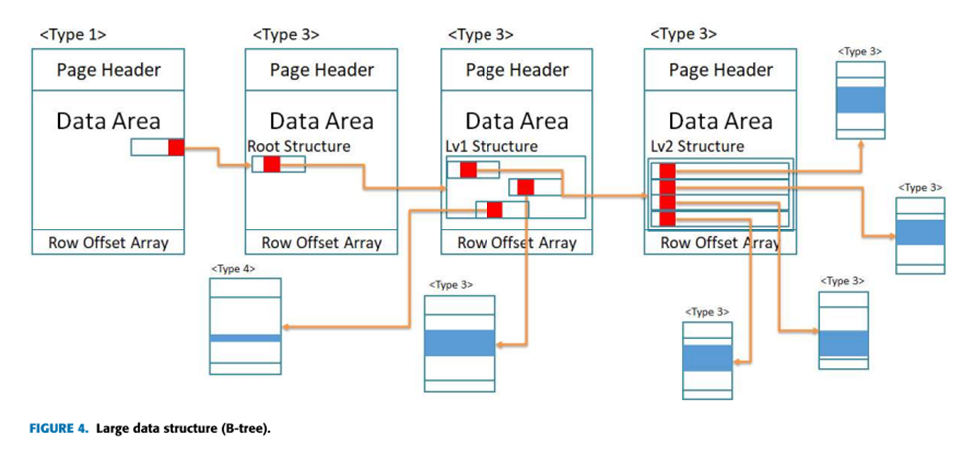
3.4 Large Data
Types Of Large Data:
Row-Overflow Data
LOB Data
Max-length Data

Slide 13
4
System Tables
Sysschobjs
Sysiscols
Syscolpars
Sysrowsets
Syscolunits
Stores all table information
Stores Index column information
Stores column information
Stores allocation unit ID
Stores partition ID of each table

Slide 14
5
Recovery Methods
4.1 Scanning
Pages
4.2 DBMS Dependent Forensic Model
4.4 DBMS Dependent Forensic Model
4.3 Database Forensic Model

Slide 15
5.1 Scanning Pages
In this phase, all pages of the data are scanned in the page units.
Following data is scanned :
Page ID
Page Object ID

Slide 16
5.2 Collecting System Table Information
This phase aims to collect the column information of the system tables.
Following data is collected:
syschoobjs
Sysiscols
sysrowsets
sysallocunits

Slide 17
5.3 Collecting User Table Information
In this phase, the information of the user table to be recovered is obtained by parsing the system table.
This phase includes following steps :
Table information in syschobjs
Column information in syscolpars
Clustered column information in sysiscols
Location information in sysrowsets and sysallocunits

Slide 18
5.4 Recovering Deleted Records
In this phase, records of the user table are recovered.
Following steps are used :
Accessing data page
Identifying unallocated data

Slide 19
6
Conclusion
Here we have researched MSSQL, which is the most used DBMS globally .We have described the internal structure of MSSQL including large data ,tornbits.To recover deleted records regardless of the MSSQL version, several system tables have been analyzed .We have proposed a method to recover deleted records and implemented the method as open source tool. Finally, the performance of our method has been verified by comparing the commercial recovery tools.

Slide 20
THANK YOU!

Slide 21
Data Recovery using Oracle
Student: Abhishek Yogesh Dhamdhere
Professor: B.C. Julme

Slide 22
TABLE OF CONTENTS
1
2
INTRODUCTION
ORACLE HISTORY
3
4
RDBMS
ORACLE STRUCTURE
5
6
RECOVERY METHODS
CONCLUSION

Slide 23
1
INTRODUCTION TO ORACLE
Developer : Larry Ellison and his two friends and former co-workers, Bob Miner and Ed Oates
Multi-model database management system
Designed for enterprise grid computing, the most flexible and cost effective.
Collection of data treated as a unit.
Purpose of a database is to store and retrieve related information.

Slide 24
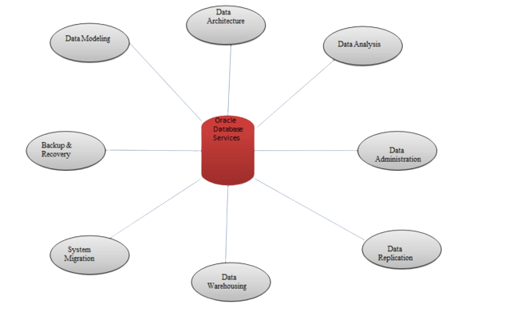
ORACLE DATABASE SERVICES

Slide 25
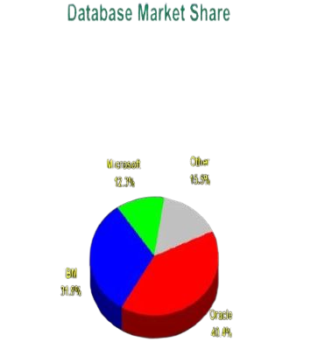
ORACLE HISTORY
2
1979 - Oracle V2
1983 - Oracle V3
1984 - Oracle V4
1985 - Oracle V5
1988 - Oracle V6
1990 - Oracle V8
1999 - Oracle 8i
2001 - Oracle 9i
2003 - Oracle 10g
2007 - Oracle 11g
2013 - Oracle 12c
2018 - Oracle 18c
2019 - Oracle 19c

Slide 26
RELATIONAL DATABASE MANAGEMENT SYSTEM
3
Oracle Database is an RDBMS.
Based on the Relational Model as introduced by E.F.Codd.
RDBMS moves data into a database, stores the data, and retrieves it.
Oracle Database has extended the relational model to an object-relational model.

Slide 27
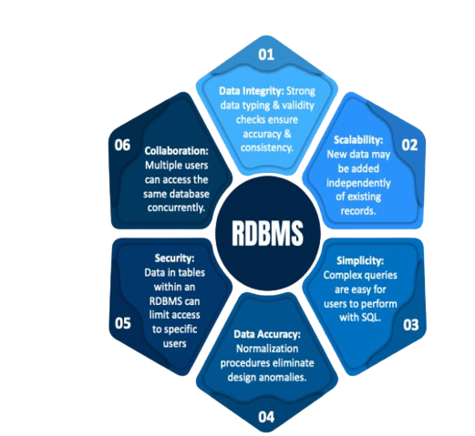
ADVANTAGES OF RDBMS

Slide 28
ORACLE FAMILY
Oracle Database Standard Edition One
Oracle Database Enterprise Edition
Oracle Database Standard Edition
Oracle Database Express Edition
Oracle Database Personal Edition

Slide 29
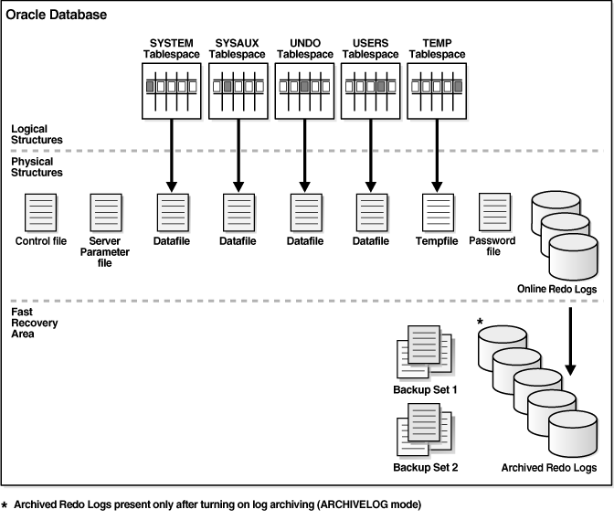
ORACLE STRUCTURE

Slide 30
ORACLE STRUCTURE
4
Physical Structure
Logical Structure
Oracle Instance
SGA
PGA

Slide 31
ORACLE STRUCTURE
4
Physical Structure
Logical Structure
Oracle Instance
SGA
PGA

Slide 32
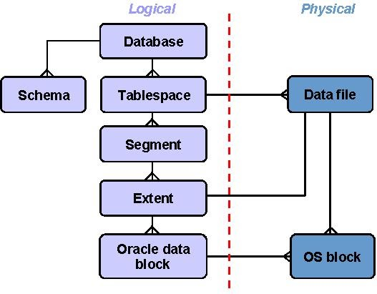
LOGICAL AND PHYSICAL STRUCTURE

Slide 33
PHYSICAL STRUCTURE
Datafiles (*.dbf)
Control Files (.ctl)
Redo Log Files (*.log)
Archive Log Files (*.log)
Parameter Files (initSID.ora)
Alert and Trace Log Files (*.trc)

Slide 34
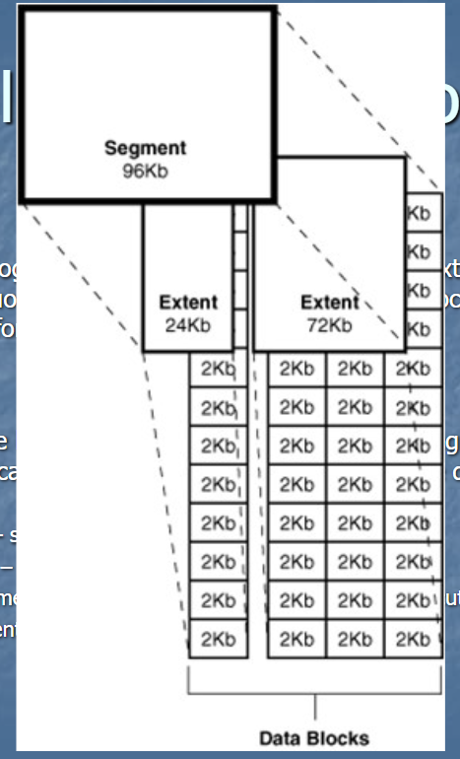
LOGICAL STRUCTURE
Tablespaces
Oracle Data Blocks
Extents
Segments
Data segment
Index segment
Temporary segment
Rollback Segment

Slide 35
ORACLE INSTANCE
SYSTEM GLOBAL AREA(SGA)
An Oracle database server consists of an Oracle database and an Oracle instance.
The combination of the background processes and memory buffers is called an Oracle instance.
The System Global Area (SGA) is a shared memory region that contains data and control information for one Oracle instance.
Users currently connected to an Oracle database share the data in the SGA.

Slide 36
MEMORY STRUCTURES OF SGA
PROGRAM GLOBAL AREA(PGA)
Database Buffer Cache - stores the most recently used blocks of data
Redo Log Buffer of the SGA - stores redo entries-a log of changes made to the database
Shared Pool of the SGA - contains shared memory constructs, such as shared SQL areas
PGA is a memory buffer that contains data and control information for a server process.
The PGA area is a non-shared area of memory created by oracle when a server process is started.

Slide 37
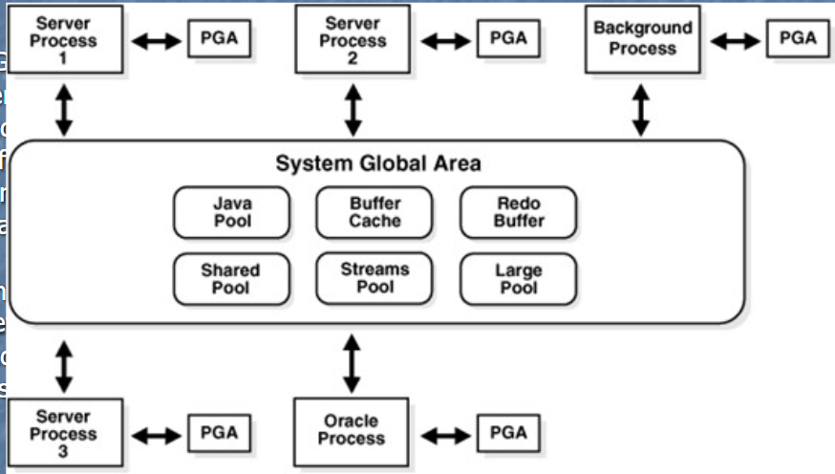

Slide 38
RECOVERY OF DATA
5
Recovery is the rebuilding of a database or table space after an interruption or failures.
Types of recovery in Oracle :
Media Recovery
RMAN and User-Managed Restore and Recovery
Oracle Flashback Technology Recovery
Instance and Crash Recovery

Slide 39
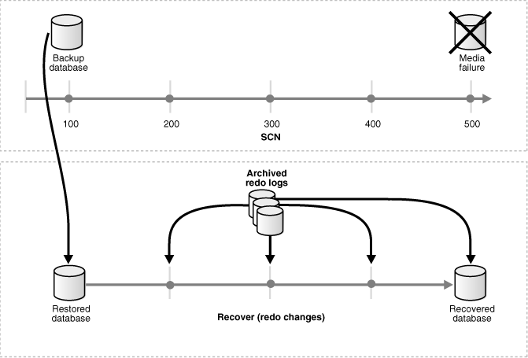
MEDIA RECOVERY
Type of recovery that takes a backup and applies redo
Applies archived redo logs and online redo logs to recover the datafiles

Slide 40
TYPES OF MEDIA RECOVERY
Complete Recovery
Incomplete Recovery
Block Media Recovery
Datafile Media Recovery

Slide 41
RMAN AND USER-MANAGED RESTORE AND RECOVERY
RMAN utility to restore and recover the database.
The basic RMAN recovery commands are RESTORE and RECOVER.
Sample Code :
{ # specify the new location for each datafile
SET NEWNAME FOR DATAFILE '/disk1/oracle/dbs/users01.f' TO
'/disk2/users01.f';
SET NEWNAME FOR DATAFILE '/disk1/oracle/dbs/users02.f' TO
'/disk2/users02.f';
SET NEWNAME FOR DATAFILE '/disk1/oracle/dbs/users03.f' TO
'/disk2/users03.f';
RESTORE TABLESPACE users;
SWITCH DATAFILE ALL; # update control file with new file names
RECOVER TABLESPACE users;
}

Slide 42
ORACLE FLASHBACK TECHNOLOGY RECOVERY
Correct problems caused by logical data corruptions or user errors.
User can recover an Oracle database to a previous time to correct problems.
It consists of :
Oracle Flashback Database
Oracle Flashback Table

Slide 43
INSTANCE AND CRASH RECOVERY
Crash recovery: To recover from a failure when a single-instance or all instances of an Oracle Real Application Clusters database fail.
Instance recovery: A case where a surviving instance recovers a failed instance.
The goal of these is to restore the data block changes and to close the redo thread left open.

Slide 44
CONCLUSION
Oracle is a powerful database server management software that can also serve the requirements of Enterprise level and small-level applications. It includes almost all the features required to support modern applications and is widely used.

Slide 45
THANK YOU!

Slide 46
Data
Recovery using MySQL and SQLite
Student : Vaishnav Avinash Bhujbal
Professor : B.C.Julme

Slide 47
MySQL
1

Slide 48
Content
Introduction
Features
Security
Permission
Methods for data recovery
Conclusion

Slide 49

Introduction to MySQL
MySQL is an open-source relational database management system (RDBMS). Its name is a combination of "My", the name of co-founder Michael Widenius's daughter My, and "SQL", the abbreviation for Structured Query Language.
A relational database organizes data into one or more data tables in which data may be related to each other; these relations help structure the data. SQL is a language programmers use to create, modify and extract data from the relational database, as well as control user access to the database.

Slide 50
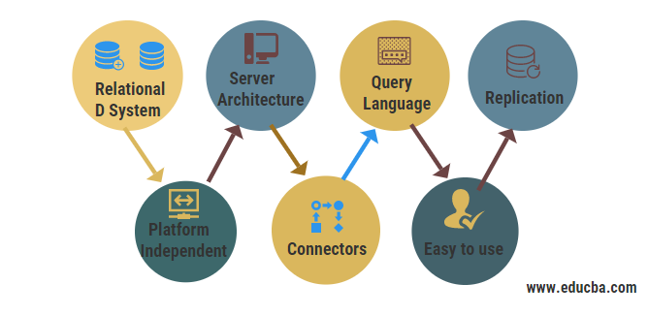
Feature

Slide 51
Security
Providing security to the database is one of the pajor part .
MySQL prompts the user to set a password that is intended to prevent unauthorized access to the program
Failure to enter the correct password results in “access denied” errors that prevent the user from accessing the databases or the information stored within them.
This is good in order to promote security and confidentiality, but problems arise when we forget the password.

Slide 52
Permission
When dealing with computer security, there are different levels of access.
An individual user typically has access only to his or her files on the computer and often is not allowed to access system files or make substantial changes to the system.
The system administrator is typically employed by the entity that owns the system. As such, the administrator should have full access to all files on the system

Slide 53
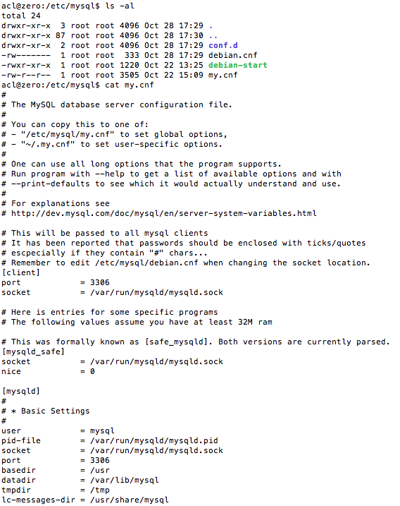
MySQL database server configuration file

Slide 54
Method to recover the data from the MySQL
Copy method
Query method

Slide 55
Copy method
This method requires the program files be copied into a new instance of MySQL on another machine (or virtual machine) where the password is known.
This will reveal the databases and their entries exactly as they would appear when the password be entered on the original instance of MySQL.
It is important to note,hat, then the new instance of MySQL must be a clean and should not have any databases, tables, or entries associated with it.
Here the first machine is the source and the instance consist of the password to access the file,tables,etc.

Slide 56
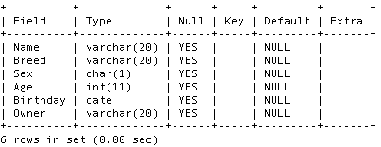
Creation of new instance with help of password
mysql> create database Dogs;
Query OK, 1 row affected (0.00 sec)
!
mysql>!use!Dogs!
Database!changed!
!
mysql>!create!table!Boarders!(Name!varchar(20),!Breed!varchar(20),!Sex!
char(1),!Age!int,!Birthday!DATE,!Owner!varchar(20));!
Query!OK,!0!rows!affected!(0.01!sec)!
!
mysql>!describe!Boarders;!

Slide 57
Creation of new instance with help of password
mysql> create database Dogs;
Query OK, 1 row affected (0.00 sec)
!
mysql>!use!Dogs!
Database!changed!
!
mysql>!create!table!Boarders!(Name!varchar(20),!Breed!varchar(20),!Sex!
char(1),!Age!int,!Birthday!DATE,!Owner!varchar(20));!
Query!OK,!0!rows!affected!(0.01!sec)!
!
mysql>!describe!Boarders;!

Slide 58
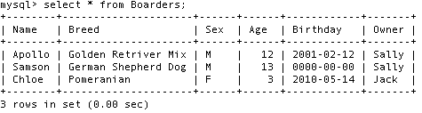
Data entries for the borders table in database
mysql>!select!*!from!Boarders;!
Empty!set!(0.00!sec)!
!
mysql>!insert!into!Boarders!values!('Apollo',!'Golden!
Retriver!Mix',!'M',!'12',!
'2001`02`12',!'Sally');!
Query!OK,!1!row!affected!(0.00!sec)!
!
Similar!statements!were!used!to!insert!two!other!entries!into!the!table

Slide 59
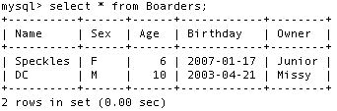
A second table is made of cats similar
to the dogs

Slide 60
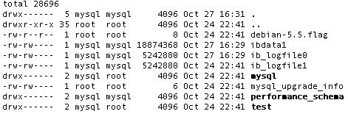
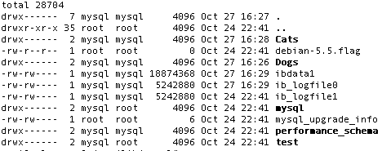
File structure before data creation
File structure after data creation

Slide 61
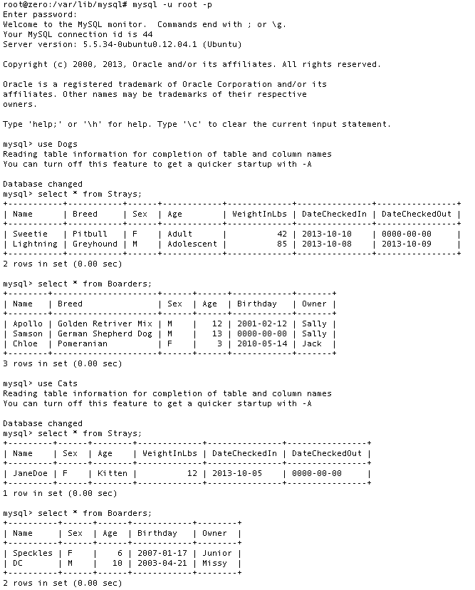
MySQL output
showing the data stored on the source machine

Slide 62
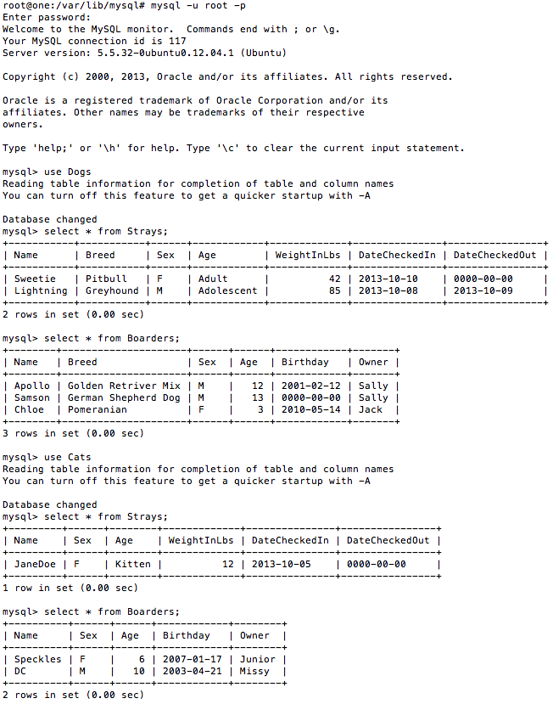
MySQL output
showing
the data stored on the clean
machine

Slide 63
Query method
With the help of the query language we can get the backup as well as we can recover any data that was previously present in the database
Following are the queries by which we can recover the data
$> mysql < backup______.sql
$> mysqlbinlog gbichot2-bin.000007 gbichot2-bin.000008 | mysql
$> mysqlbinlog gbichot2-bin.000009 ... | mysql

Slide 64
Query information
$> mysql < backup______.sql
This requires recovery from backups. To recover, first we restore the last full backup we havewith us
$> mysqlbinlog gbichot2-bin.000007 gbichot2-bin.000008 | mysql
To restore the changes made since then, we must use the incremental backups; that is, the gbichot2-bin.000007 and gbichot2-bin.000008 binary log files. Fetch the files if necessary from where they were backed up, and then process their contents as shown above
$> mysqlbinlog gbichot2-bin.000009 ... | mysql
the server with a --log-bin option that specifies a location on a different physical device from the one on which the data directory resides. That way, the logs are safe even if the device containing the directory is lost.) If we had done this, we would have the gbichot2-bin.000009 file (and any subsequent files) at hand, and we could apply them using mysqlbinlog and mysql to restore the most recent data changes with no loss up to the moment of the crash

Slide 65
Conclusion
Recovery of data is possible with the help of the password which is required for accessing the database.
With the help of the queries that are provided in the library retrieval of data is possible from the database.

Slide 66
2
SQLite

Slide 67
Content
Introduction
Technical background
Methods and Algorithm
FQ Lite Recovery tool
Conclusion

Slide 68
Introduction to SQLite
SQLite was developed by D.Richard Hipp in August 2000.
SQLite is a open source database.
SQLite supports Standard Relational Database feature.
It is serverless and Zero-configuration database engine.
For example, Safari, Mozilla Firefox, and Google Chrome use SQLite version 3 databases to manage user data such as history, cookies, and downloaded files.
Notes:
It does not require any separate server to operate
Very small and light weight
It is self contained

Slide 69
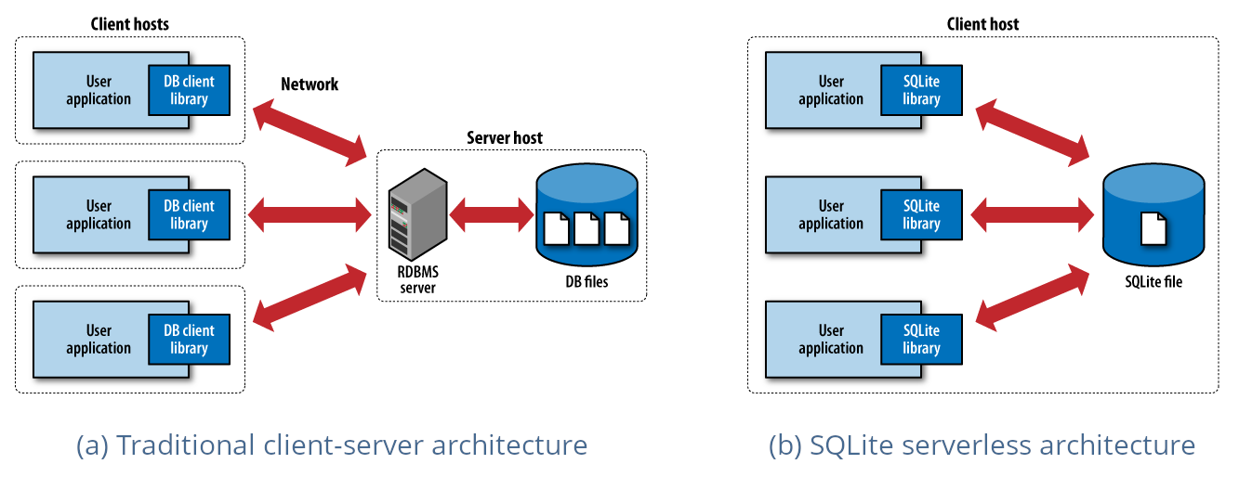

Slide 70
Technical Background
Similar to the relational databases, all data is managed in tables. A table, in turn, is composed of several pages. Similar to blocks in a file system, a page is used to store data (Haldar, 2015). It can, therefore, contain multiple records.
Each page has a variable size - the default size is 4096 bytes
The maximum size for an SQLite page is 65536 bytes.
Basically the first page is reserved for the header (100 bytes) which is followed by the database schema
Notes:
Before we turn to recover deleted records, let us first discuss some basics of building and managing SQLite databases. When
considering how to reclaim data that have been removed or overwritten, we first have to talk about the way SQLite organizes
its dataset. The pages are numbered. The first
page in the database has the number 1. It is reserved exclusively for the database header.

Slide 71
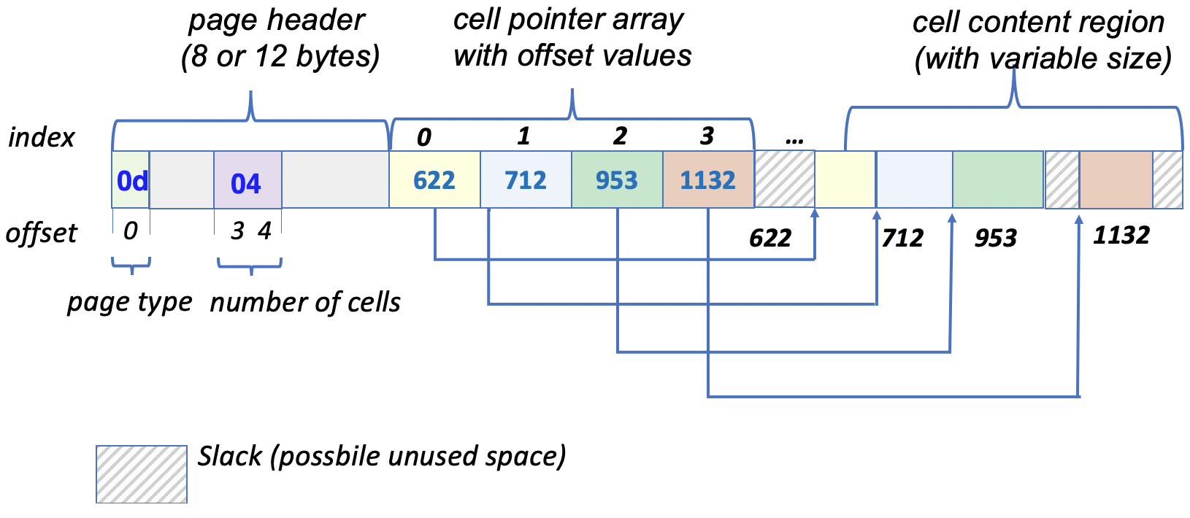
Structure of data page in SQLite

Slide 72
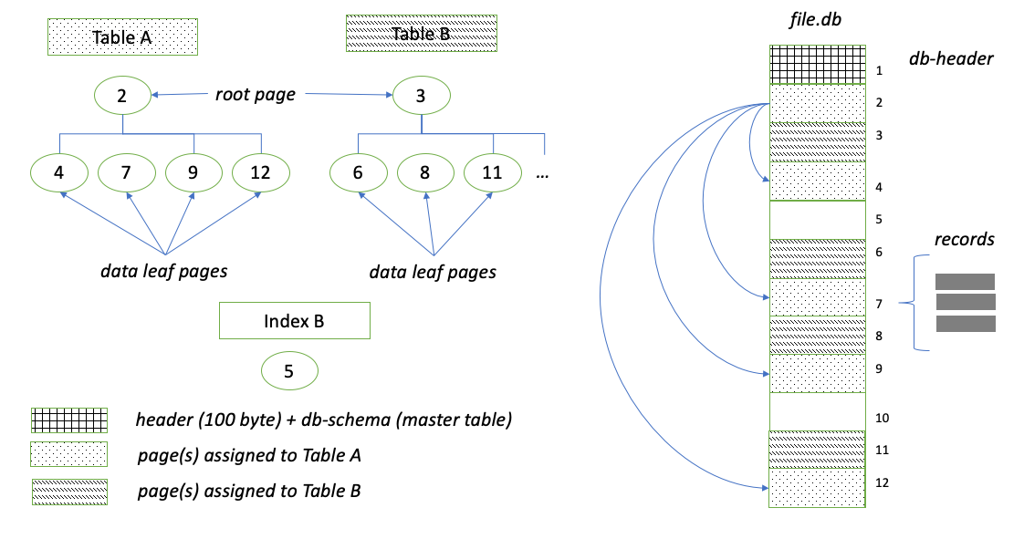
Balance tree structure (B-tree)
Notes:
This is a straightforward and highly efficient way to store data
The layout of B-tree pages in SQLite is similar to the layouts used in many other relational DBMS
Here there are nodes and leaf node .
The nodes are only for the connection whereas the leaf are used to store the data records
All data records are stored in a unique binary format

Slide 73
Method to recover the data from the SQLite
Examine the free-page list
Carving for more artefacts

Slide 74
Examine the free-page list
Here we can recover the data where one or more pages have been completely deleted from the database.
For this purpose we have to first find the free page list’s jump address for this it is necessary to get the starting address
For this we have an equation to find the first free memory page
Notes:
From a technical point of view, all the database's free memory pages are linked together in a list.

Slide 75
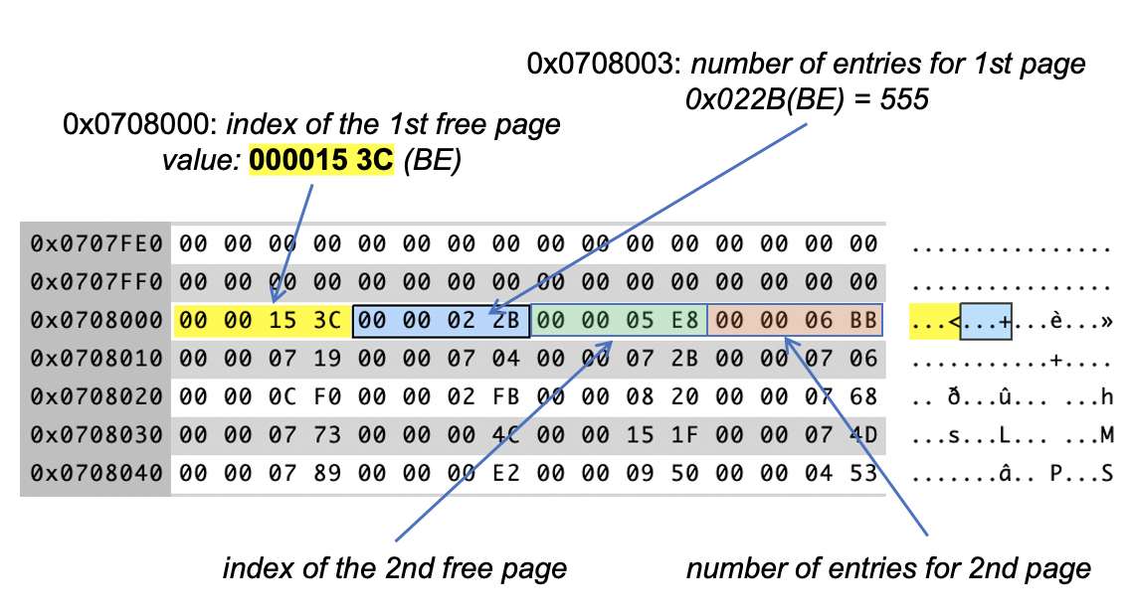
Jump address equation
Jump to address =((4 Byte BE in offset 32)-1)*page size (1)
In the above example, the list, therefore, starts at the beginning
Jump to hex=(0x0709-1)* 0x1000 =0x708000
Jump to decimal =(1801-1)* 4096
=7372899

Slide 76
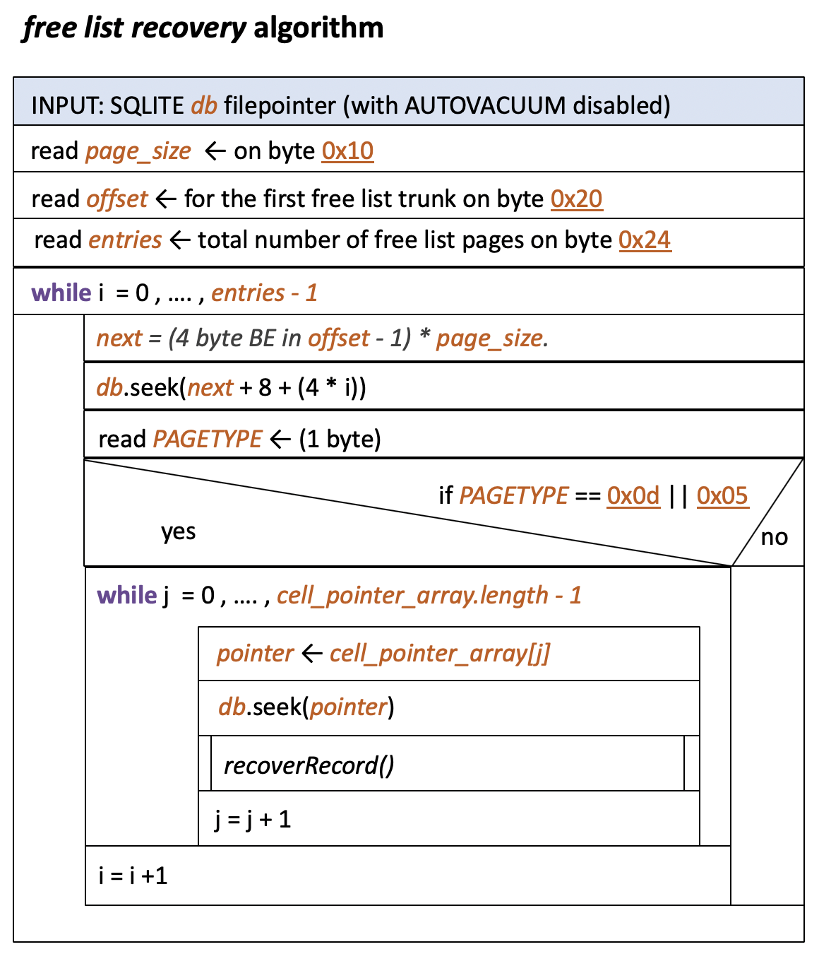
Free page list recovery algorithm

Slide 77
Carving for more artefacts
In this method we deal with finding the slack spaces.
Sometimes individual records are deleted from a table, they can occur.
Hence, we have to carve for the hidden records inside all data pages

Slide 78
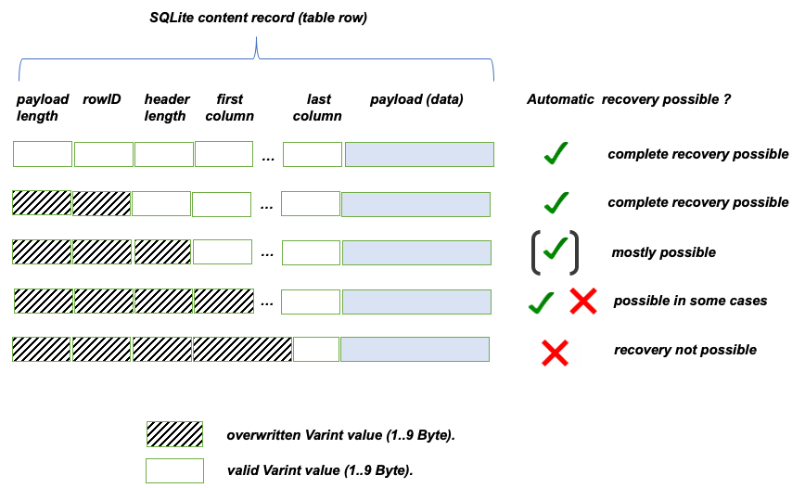
Deleted record and their structure

Slide 79
The FQ Lite Recovery Tool
To make the deleted information visible again, we use an App which is called FQ Lite.
This program allows someone to recover deleted entries from an SQLite3 database
This operational model offers the highest performance and should be used for time-critical investigations.
On the console, we only need to specify the input path of the database to be analyzed. The extraction process is entirely automatic.

Slide 80
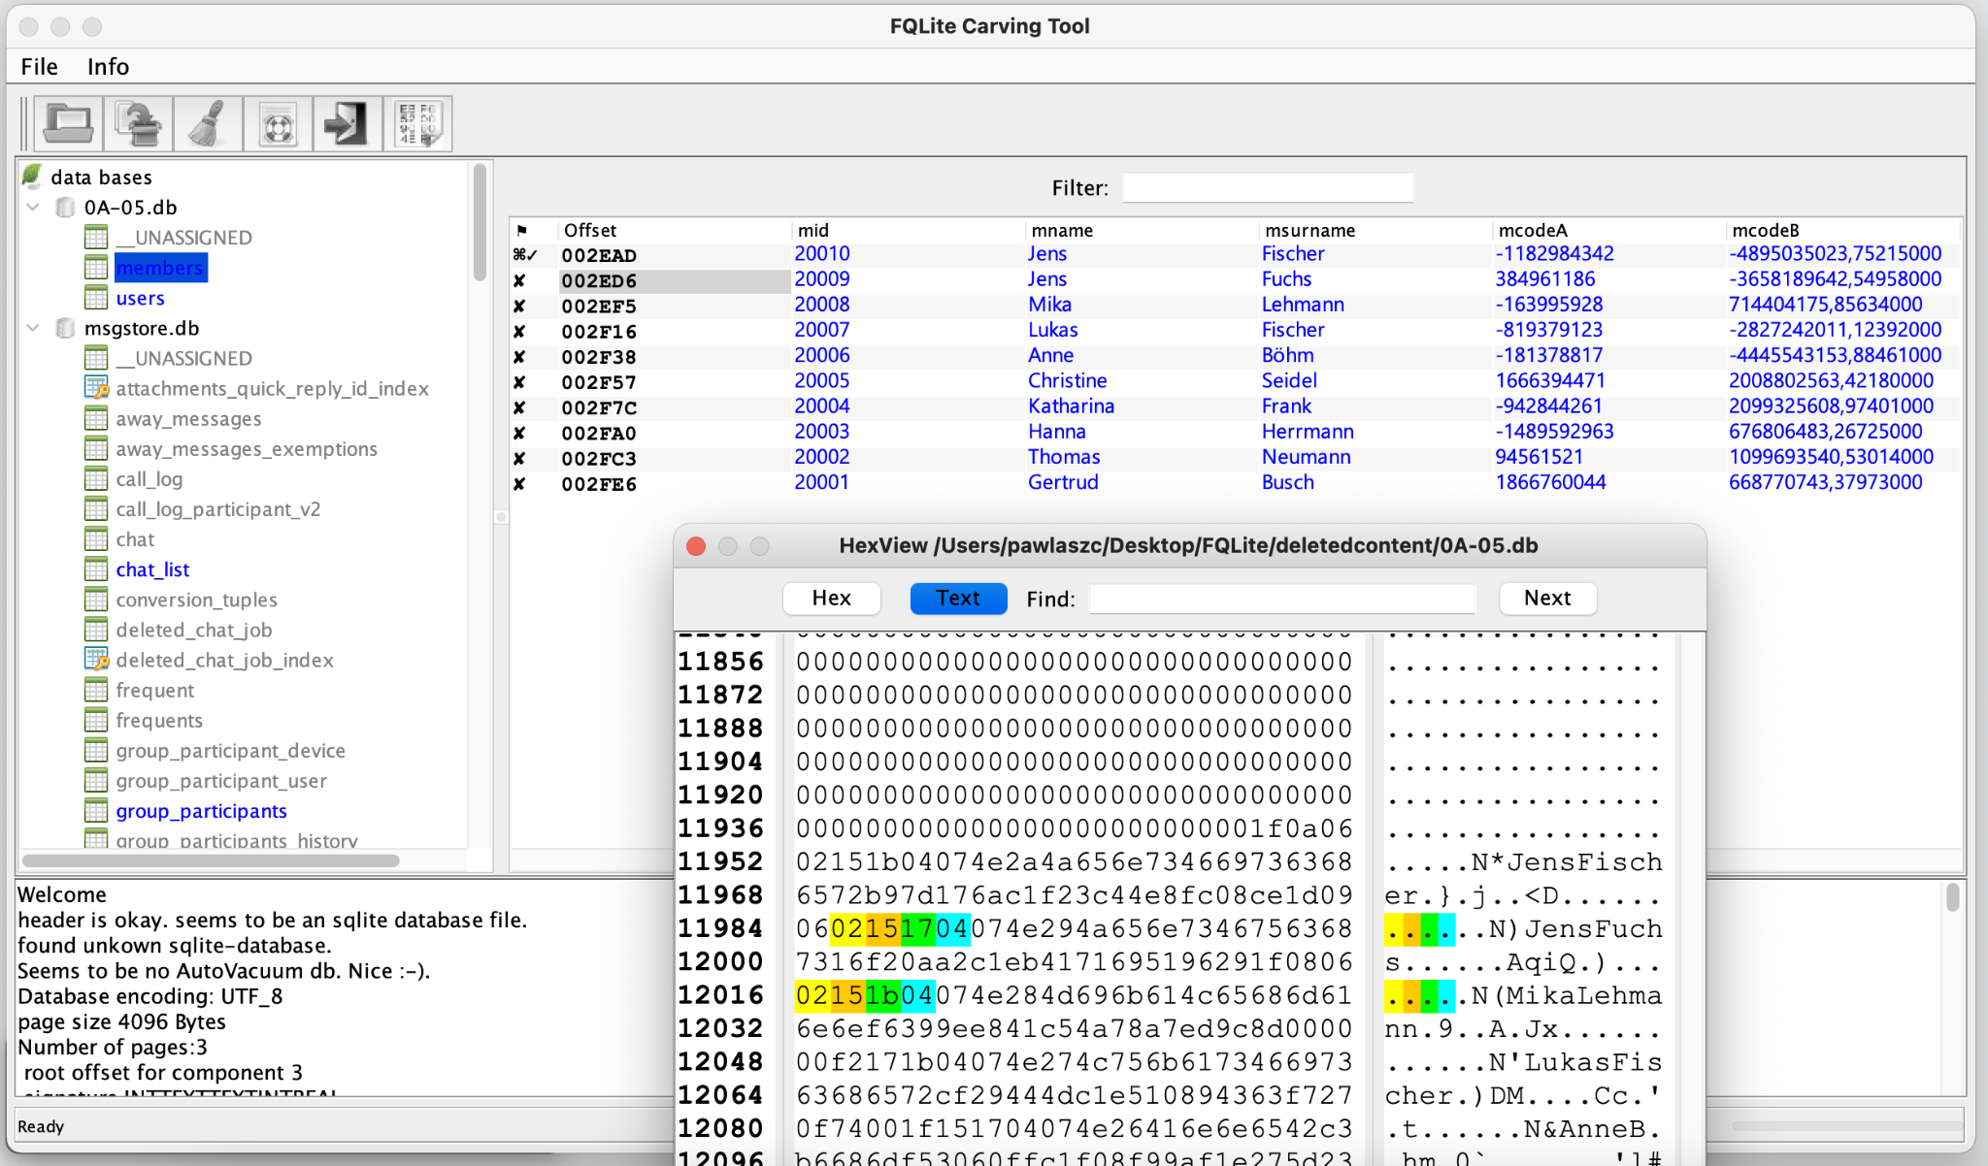
FQ Lite data retrieval tool interface

Slide 81
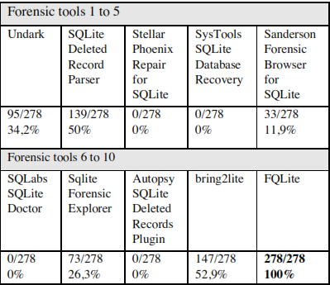
Recovery rate of FQ Lite compared to other tools

Slide 82
Conclusion
In this article, we presented some techniques for carving of deleted data in SQLite databases.
Besides an algorithm for the recovery of deleted data pages,
As proof of concept, an open-source application named FQLite was presented, which implements all proposed techniques for recovery of data

Slide 83
Thank you

Slide 84
NoSQL
“Towards the end of RDBMS?”
Student : Neha Bhosale
Professor : B.C.Julme

Slide 85
TABLE OF CONTENTS
1
2
INTRODUCTION
TYPES OF NoSQL
3
4
ARCHITECTURE
RDBMS V/S NoSQL
5
6
RECOVERY METHODS
CONCLUSION

Slide 86
1
Introduction to NoSQL :
NoSQL databases (aka "not only SQL") are non-tubular databases and store data differently than tables.
NoSQL database technology stores information in JSON documents instead of columns and rows used by relational databases.
Consequently, NoSQL databases are built to be flexible, scalable, and capable of rapidly responding to the data management demands.

Slide 87
NoSQL Database Features :
Each NoSQL database has its own unique features. At a high level, many NoSQL databases have the following features:
Flexible schemas
Horizontal scaling
Fast queries due to the data model
Ease of use for developers

Slide 88
Why NoSQL?
Faster than SQL database.
Control of the structure of the data.
Path to data scalability is straightforward.

Slide 89

Where to use NoSQL ?
NoSQL Data storage systems makes sense for applications that process very large semi-structured data-like Log Analysis, Social Networking Feeds, Time-based data.
To improve programmer productivity by using a database that better matches on application's needs.
To improve data access performance via some combination of handling larger data volumes, reducing latency, and improving throughput.

Slide 90
2
Types of NoSQL databases :
Over time, four major types of NoSQL databases emerged: document databases, key-value databases, wide column stores, and graph databases.
Key-value databases
Document databases
Wide-column stores
Graph databases

Slide 91
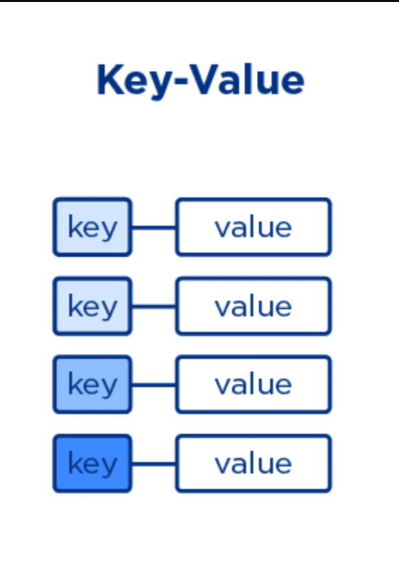
Key-Value Databases :
Records are stored and retrieved using a key that uniquely identifies the record, and is used to quickly find the data within the database.
Example: CouchDB, Oracle NoSQL Database, Riak etc.

Slide 92
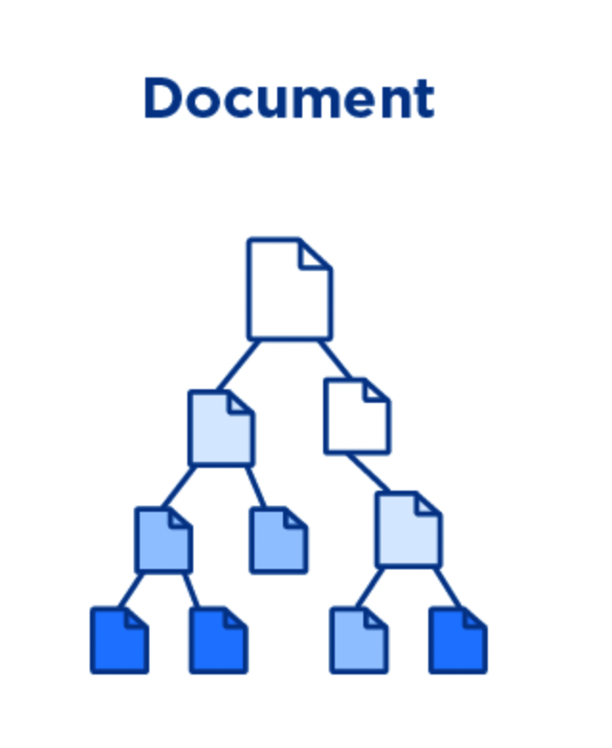
Document Databases :
The database stores and retrieves documents. It stores documents in the value part of the key-value store.
Self-describing, hierarchical tree data structures consisting of maps, collections, and scalar values.
Example: Lotus Notes, MongoDB, Couch DB, Orient DB, Raven DB.

Slide 93

Wide-Column Databases :
It store data as Column families containing rows that have many columns associated with a row key. Each row can have different columns.
Column families are groups of related data that is accessed together.
Example: Cassandra, HBase, Hypertable.

Slide 94
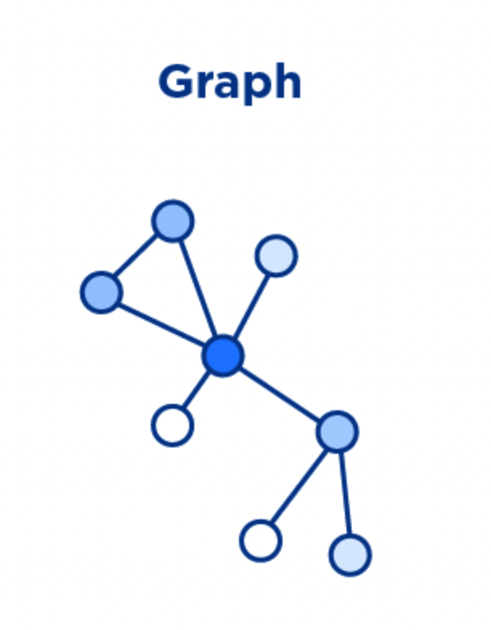
Graph Databases :
Store entities and relationships between these entities as nodes and edges of a graph respectively. Entities have properties.
Traversing the relationships is very fast as relationship between nodes is not calculated at query time but is actually persisted as a relationship.
Example: Neo4J, Infinite Graph, OrientDB, FlockDB.

Slide 95
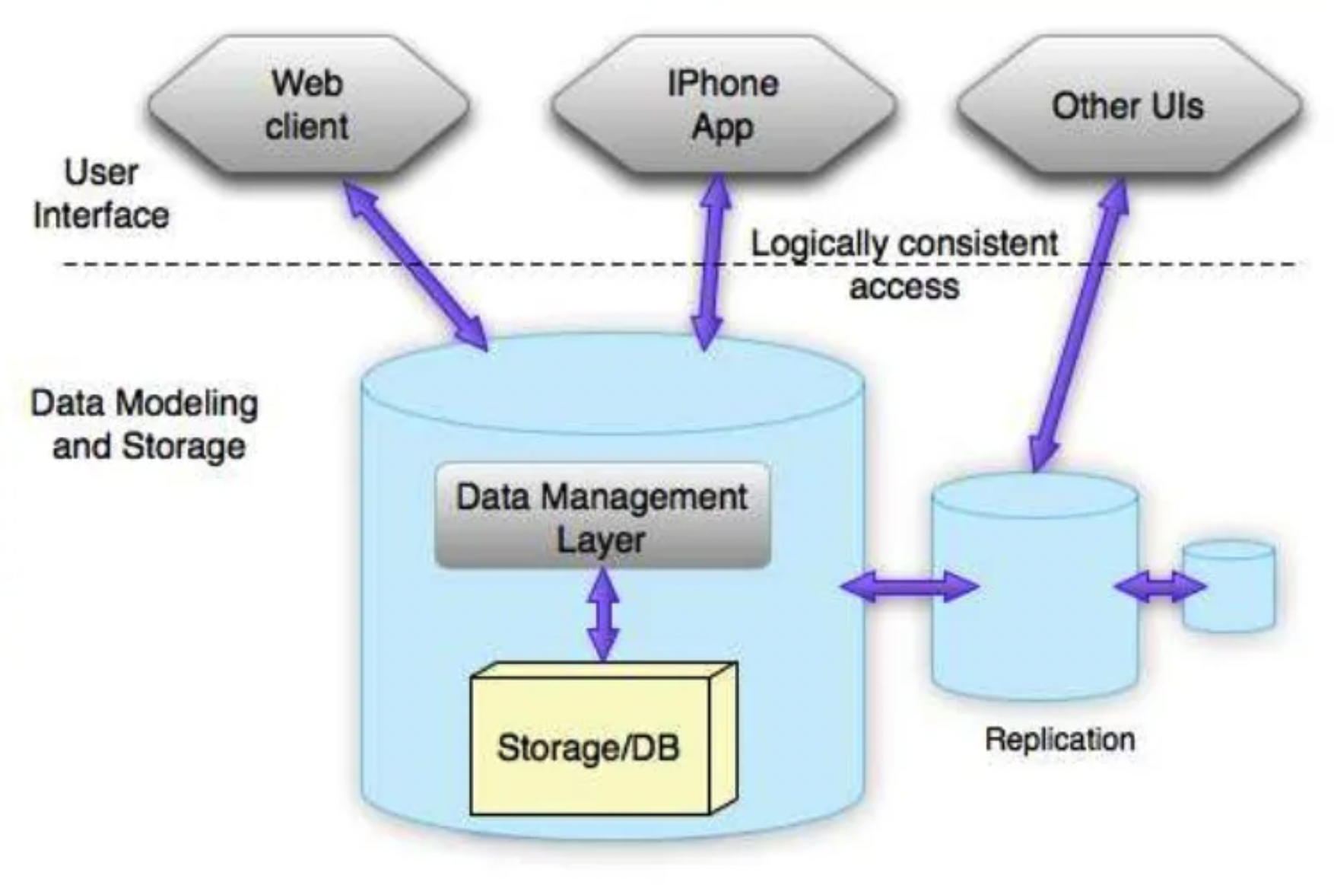
3
Architecture :
Notes:
Cylinder-nodes!!!!
Two layers!!!

Slide 96
Advantages of NoSQL :
Cheap and easy to implement (open source).
Data are replicated to multiple nodes (therefore identical and fault-tolerant and can be partitioned).
No single point of failure.
Easy to distribute.
Don't require a schema.

Slide 97
Disadvantages of NoSQL :
One of the most frequently cited drawbacks of NoSQL databases is that they don't support ACID (atomicity, consistency, isolation, durability) transactions across multiple documents.
Integration with applications that are based on SQL.
Queries are less flexible.
Less mature.

Slide 98
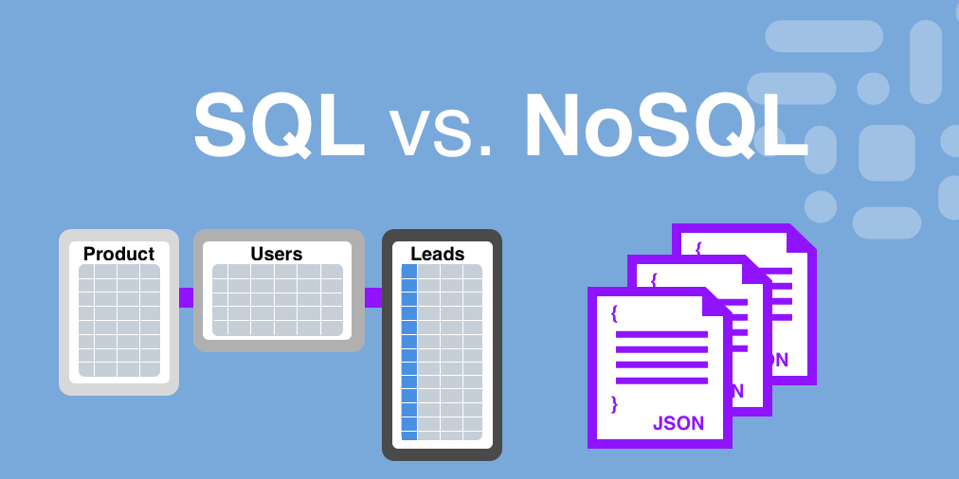
4
RDBMS v/s NoSQL databases :

Slide 99
Difference between RDBMS and NoSQL databases :
Relational Database :
NoSQL :
Used to handle data coming in low velocity.
Gives only read scalability.
Manages structured data.
Data arrives from one or few locations.
Supports complex transactions.
Deployed in vertical fashion
Used to handle data coming in high velocity.
Gives both read and write scalability.
Manages all type of data.
Data arrives from many locations.
Supports simple transactions.
Deployed in Horizontal fashion.

Slide 100
5
Recovering NoSQL Databases :
NOSQL UNDO uses two methods to undo the effects of incorrect operations leaving the database in a correct state: full recovery and focused recovery. Both methods take as input a list with operations to undo.
Full-Recovery
Focused-Recovery

Slide 101
Full-Recovery :
The full recovery algorithm is the simplest recovery method among the two.
It works by loading the most recent snapshot of the database, then it updates the state by executing the remaining operations, which were previously recorded in a log.
The algorithm takes as input a list of incorrect operations that it is supposed to ignore when it is executing the log operations.

Slide 102
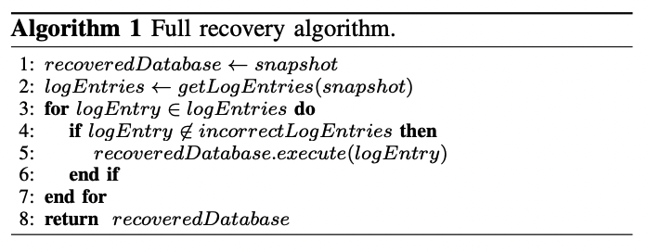
Algorithm for Full-Recovery :

Slide 103
Focused-Recovery :
The idea behind Focused Recovery is that instead of recovering the entire database just to erase the effects of a small set of incorrect operations.
Only compensation operations are executed.
A compensation operation is an operation that corrects the effects of a faulty operation.

Slide 104
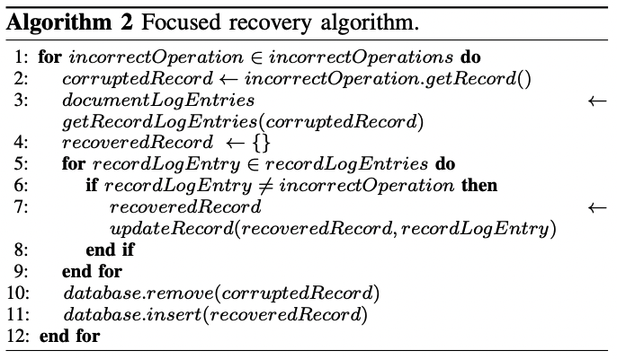
Algorithm for Focused-Recovery :

Slide 105
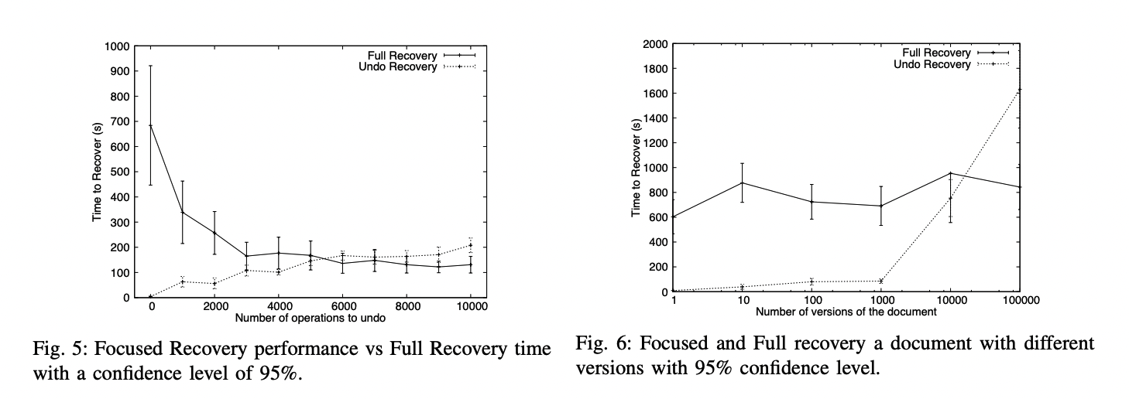
Full-Recovery v/s Focused-Recovery :

Slide 106
6
Conclusion :
NoSQL database provides us many benefits, consistency, availability and partition tolerance. It also provides facilities to easily store the graph data, which is not available with SQL databases. Also NoSQL Databases helps us with recovery of data and managing the recovered data.

Slide 107
THANK YOU!
Please keep this slide for attribution

